Slide 1
Career Development Training Course
Reenlistments and Contract Extensions

Slide 2
Enabling Objectives
DEFINE reenlistment and extensions
IDENTIFY the eligibility factors for reenlistments
IDENTIFY the eligibility factors for extensions of enlistments
IDENTIFY when the OBLISERV to Train (OTT) option is available
IDENTIFY when Page 13 in lieu of OBLISERV is available
IDENTIFY the difference between EAOS and SEAOS
IDENTIFY the reasons for extension cancellations
DETERMINE when leave sell-back is authorized
Notes:
FACILITATORS GUIDE:
Review objectives.

Slide 3
References
MILPERSMAN 1160-030, Enlistments and Reenlistments Under Continuous Service Conditions
MILPERSMAN 1070/621, Agreement to Extend Enlistment
MILPERSMAN 1160-040, Extension of Enlistments
MILPERSMAN 7220-340, Lump-Sum Payment for Accrued Leave
OPNAVINST 1160.8 (series), Selective Reenlistment Bonus Program
MILPERSMAN 1160-020, Reenlistment Ceremony
MILPERSMAN 1160-120, High Year Tenure
Notes:
FACILITATOR GUIDE:
Review references.

Slide 4
Reenlistment and Extensions Defined
What is a Reenlistment?
MILPERSMAN 1160-030
When a member has previously served an enlistment in the active or reserve component, the next enlistment therein will be termed a “reenlistment.”
Official form:
NAVPERS 1070/601, Immediate Reenlistment Agreement
What is an Extension?
MILPERSMAN 1160-040
An agreement between the U.S. Government and the enlisted member to extend the current enlistment in the Navy or Naval Reserve.
Official form:
NAVPERS 1070/621, Agreement to Extend Enlistment
Notes:
FACILITATOR GUIDE:
None

Slide 5
Reenlistment Eligibility
U.S. Citizen; Noncitizen nationals; or Immigrant alien members who have been lawfully admitted into the U.S.
Medically qualified
Meet HYT requirements
Meet Professional Growth Criteria:
Serving as a Petty Officer; or
E-3 and approved for SRB; or
E-3 and approved to convert from TAR to AC
Receive a minimum recommendation of "Promotable" and recommended for retention on last graded evaluation (none observed evaluations are not considered graded)
Physical fitness requirements:
Refer to OPNAVINST 6110.1 (series), Physical Readiness Program and current NAVADMINS to determine physical fitness eligibility
Notes:
FACILITATOR GUIDE:
1. Discuss reenlistment eligibility and any applicable updates
2. Enlisted members with two or more consecutive PFA failures will result in adverse actions that can affect reenlistment.
NOTE: OPNAVINST 6110.1J, removed mandatory ADSEP processing for PFA failures

Slide 6
High Year Tenure (HYT)
MILPERSMAN 1160-120
The high year tenure (HYT) policy is a vital and effective force management tool utilized to properly size and shape the Active Component (AC) and Reserve Component (RC)
HYT management is regulated by establishing standardized length-of-service (LOS) gates by pay grade balanced with a waiver process to enable the Navy to retain the right number of members
**Reference HYT specific NAVADMINS for recent changes**
Notes:
FACILITATOR GUIDE:
Inform CDT to always verify current MPM and NAVADMINs that address HYT policy to determine a member’s eligibility.

Slide 7
HYT Limits
Notes:
FACILITATOR GUIDE:
Review HYT limits…discuss any recent changes if applicable.

Slide 8
Requirements for Reenlistment
Reenlistment ceremonies:
MILPERSMAN 1160-020
Required counseling:
MILPERSMAN 1160-031
C-Way approval required for all rated E-3 through E-6 with less than 14 years of service
Terms of reenlistment are: 2, 3, 4, 5, or 6 years
New contract must equal or exceeds period of service member is already obligated
SRB reenlistments require minimum term of 3 years
Notes:
FACILITATOR GUIDE:
Speak on unique/significant reenlistment ceremonies you have facilitated or witnessed that stood out (fun location, deployments, etc.).
Early reenlistments:
No requirement to forward to PERS-811 for approval
Applies to all Sailors regardless whether or not the member is subject to CWAY approval
Conditional reenlistments:
Required PERS-811 approval (AC), PERS-812 approval for (RC)
Example of when this type may be required: Sailor has 48 months of operative extension, are eligible for reenlistment and require a OBLISERV (i.e. Fleet Reserve to meet approved fleet reserve date)
See MPM 1160-030 for additional reasons for conditional reenlistments

Slide 9
Reenlistment Incentives
Selective Reenlistment Bonus (SRB):
OPNAVINST 1160.8(series) / NAVADMINs
Award levels can change at any time and are updated via the current SRB Award Level Excel on MyNavy HR
Requests must be submitted 120-35 days prior to the desired reenlistment date vis NSIPS
Must reenlist for a minimum of 3 years
Selective and Training Reenlistment Bonus (STAR):
MILPERSMAN 1160-100
First term Sailors may be eligible for:
Guaranteed assignment to a “C” school
Advancement from PO3 to PO2 upon completion of “C” school
SRB, if eligible
Must obtain approval prior to re-enlisting
NOTE: SRB and ESRP will be discussed in detailed in lesson 2.2 Military Compensation and Incentive Pay
Notes:
FACILITATOR GUIDE:
The two listed are the current reenlistment incentives. All others listed in MPM 1306-1000 have been cancelled.
More in-depth information is listed on the Incentives slides lesson 2.2

Slide 10
Reenlistment Ceremony
MILPERSMAN 1160-020
“During a reenlistment ceremony, the reenlisting Sailor makes a personal commitment in a public forum to wear the cloth of the nation with honor, courage and commitment.”
Who CAN ADMINISTER THE OATH?: Per 10 U.S.C. 502(a), The President, Vice President, Secretary of Defense, and any commissioned officer and any other person designated under regulations prescribed by the Secretary of Defense.
Where: Venue shall reflect pride, professionalism and dignity for the oath and Navy
Attire: In Uniform
NOTE: Senior enlisted CANNOT officially administer the Oath of Enlistment
Notes:
FACILITATOR GUIDE:
Ensure to emphasize that Senior Enlisted cannot administer the Oath of Enlistment. This also includes civilian family members (spouse, kids, etc.).
Who: Per reference (a) (10 U.S.C. 502(a) ), the President, the Vice-President, the Secretary of Defense, any commissioned officer, and any other person designated under regulations prescribed by the Secretary of Defense may administer the reenlistment oath. Senior enlisted CANNOT officially administer the Oath of Enlistment
Where: Each reenlistment shall be performed in uniform and should be memorable with the right tone and venue to reflect pride, professionalism, respect, and dignity for the oath and the United States Navy. Examples include members command (standing on the anchor, under the ship while in dry dock, etc.), sporting events (on the field during a game), landmarks (USS MIDWAY, beach), or a location significant to the member.
Attire: Both the Sailor reenlisting and the reenlisting officer are required to be in uniform.

Slide 11
Extension of Enlistments
MILPERSMAN 1160-040
Conditional:
Extensions are executed as prescribed and are for periods of 1-48 months
Dates:
Execution date = the date signed
Operative date = date the extension goes into effect (EAOS + 1 day)
Notes:
FACILITATOR GUIDE:
None.

Slide 12
Reasons to Extend Enlistment
COs and OICs can authorize extensions without PERS approval to include CWAY, if they are for one of the following reasons:
Match EAOS with PRD
Obtain Maternity Care Benefits (self or spouse)
Obtain OBLISERV for Orders
Obtain OBLISERV as required by Navy directives, NAVADMIN, or MILPERSMAN (ex. to Fleet Reserve/Retirement date or HYT)
Exception: Nuclear Trained Sailors seeking extensions beyond 23 months require approval from OPNAV N133.
Notes:
FACILITATOR GUIDE:
None.

Slide 13
Cancellation of Extensions
Extensions may be cancelled if:
Sailor extends for benefit, but it is not received through NO fault of their own
Disenrolled from specialized course through NO fault of their own
Reenlists
Must reenlist beyond the SEAOS date. (extensions are automatically cancelled upon reenlistment)
Is no longer recommended for retention:
Evaluation
Not approved for C-Way quota
Loss of required security clearance
Is found to be not physically qualified
Note: Extensions that have become OPERATIVE may not be cancelled.
Notes:
FACILITATOR GUIDE:
Examples of extension with benefits are:
School,
Accelerated advancement,
Did not execute PCS orders,
Enlistment bonus

Slide 14
OBLISERV To Train (OTT)
OPNAVINST 1160.8(series)
A member who receives orders to attend training and acquire a qualifying SRB NEC, but lacks the required obligated service to complete the training.
Open to Sailors who:
Have A NEC qualifying schools in route, or are converting to a qualifying rate.
Who are not already SRB-eligible and whose EAOS (as extended) is prior to graduation date as written on orders.
1306/7 request must be submitted to BUPERS-328 via MNCC.
NOTE: OTT will be discussed in detailed in lesson 2.2 Military Compensation and Incentive Pay
Notes:
FACILITATOR GUIDE:
MILPERSMAN 1306-604.
The OTT program is managed by NPC, Pers-4811.

Slide 15
Page 13 in Lieu
If extension of enlistment for 24 months or less will not completely satisfy the required OBLISERV, the command/TSC is authorized to use a page 13 (NAVPERS 1070/613) entry in lieu of hard OBLISERV for periods not to exceed 12 months per MPM 1306-106.
Some assignments do not allow the use of a page 13 in lieu of hard OBLISERV - see paragraph 4 of MPM 1306-106. Page 13s for more than 12 months must be authorized by Pers-451.
Notes:
FACILITATOR GUIDE:
None.

Slide 16
Lump Sum Leave (LSL)
MILPERSMAN 7220-340
Limit: 60 days maximum in a military career
Monetary entitlement payable:
Reenlistment
Separation from Active Duty
The effective date of a first extension of enlistment
Death
LSL Calculation:
Base Pay/30= Daily Norm or Daily Base Rate (DBR)
DBR x number of days = LSL
Notes:
FACILITATOR GUIDE:
None.

Slide 17
Forms
NPPSC 1160/1 Command Career Request
Used for both reenlistments and extensions
MyNavy HR > References > Forms > NPPSC Forms
Notes:
FACILITATOR GUIDE:
None.

Slide 18
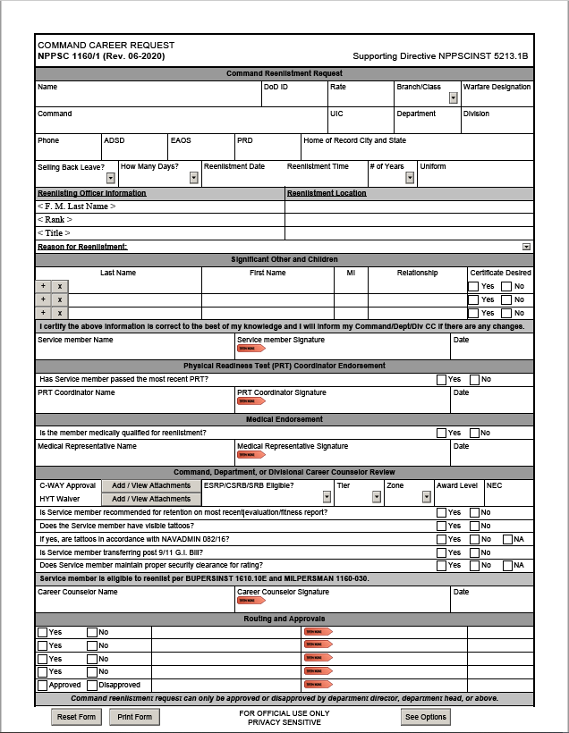
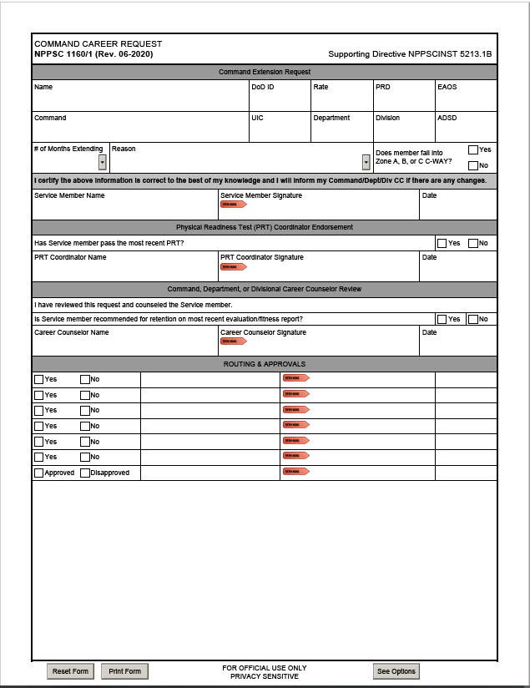
Command Career Request NPPSC 1160/1
Reenlistment Request
Extension Request
Notes:
FACILITATOR GUIDE:
See screenshot.

Slide 19
Best Practices
Discuss GI Bill transferability requirements
Minimum of 6 years of service required with a 4-year obligation
Sailors have 30 days from date of reenlistment to transfer benefits with a 4-year reenlistment
Ensure SRBs are submitted as early as possible (120-35 days prior to reenlistment day)
Download loss reports monthly via NSIPs to ensure accurate tracking of personnel
Maintain 15-month roller with member's career decisions
Follow up! Ensure EAOS/SEAOS are updated, SRB approval messages are received, CWAY status is reflecting to prevent delays in creating contracts
Use excel to calculate dates for you (e.g. calculate 120 days from the reenlistment date to know when to submit SRB pre-certs)
Ensure to verify current SRB multiples on MyNavy HR.
Notes:
FACILITATOR GUIDE:
Add any best practices/experiences you have here.
Show example of 15 month roller
Is there a specific template you want your Dept/Div CC’s to use? If so, train to it so they are aware of your expectations.

Slide 20
Knowledge Check
Use the Sailor details below to answer the questions.
Can NC1 Joe Navy reenlist on the requested date? Explain your answer and the reference
What is the maximum amount of time NC1 could reenlist for and why?
Is he affected by the current HYT policy and require a HYT waiver?
NC1 Joe Navy
ADSD: 6/15/2005
EAOS: 2/28/2024
SEAOS: 3/1/2025
Requested reenlistment date: 6/15/2023
Not eligible for SRB
Notes:
ANSWERS:
YES, Member could reenlist as early as they want as long as their new EAOS exceeds past their current SEAOS. Reference MPM 1160-030.
Maximum of 3 years, new EAOS would be 6/14/26. Must reenlist day for day for what is currently reflecting on enlistment contract.
Must cover remaining 21 months on contract
No the HYT for first class is 22 years.

Slide 21
Summary and Review
In this lesson we discussed:
Defined reenlistment and extensions
The eligibility factors for reenlistments and extensions of enlistments
HYT
Reenlistment incentives
Reenlistment ceremonies
OBLISERV to Train (OTT)
Extension cancellations
Leave sell-back

Slide 22
Reenlistments and Extensions
Questions?

